Slide 1
Reinforcement Learning

Slide 2
Course Information
Prerequisites: 1. CS60010: Deep Learning.
Python Proficiency: Proficiency in Python. Familiarity with some Deep Learning tools (Tensorflow, Pytorch etc.) could be handy. A few links to get started.
https://docs.python.org/3/tutorial/
http://cs231n.github.io/python-numpy-tutorial/

Slide 3
Course Materials
Books and References:
“Reinforcement Learning: An Introduction”, Richard S. Sutton and Andrew G. Barto, 2nd Edition, Free link.
“An Introduction to Deep Reinforcement Learning”, Vincent François-Lavet, Peter Henderson, Riashat Islam, Marc G. Bellemare and Joelle Pineau, Free link.
“Algorithms for Reinforcement Learning”, Csaba Szepesvari, Free link.
[For Probability Primer] - “Probability, Statistics, and Random Processes for Electrical Engineering”, 3rd Edition, Alberto Leon-Garcia, Free link.
[For Probability Primer] - Lecture Notes on Introduction to Probability, Dimitri P. Bertsekas and John N. Tsitsiklis, Free link

Slide 4
Online Material
Online lecture Videos: The following courses will be closely followed in this course
Reinforcement Learning by David Silver (Link)
Deep Reinforcement Learning by Sergey Levine (Link)
NPTEL Reinforcement Learning by Balaraman Ravindran (Link)

Slide 5
Course Information
Evaluation: 100
Sessional’s + End Sem = 80
TA = 20
LAB: 60
Exam 1: 30
Project: 30

Slide 6
Reinforcement Learning
“Goal-directed learning from interaction in an uncertain environment” – Reinforcement Learning: An Introduction, Sutton and Barto, Second Edition

Slide 7
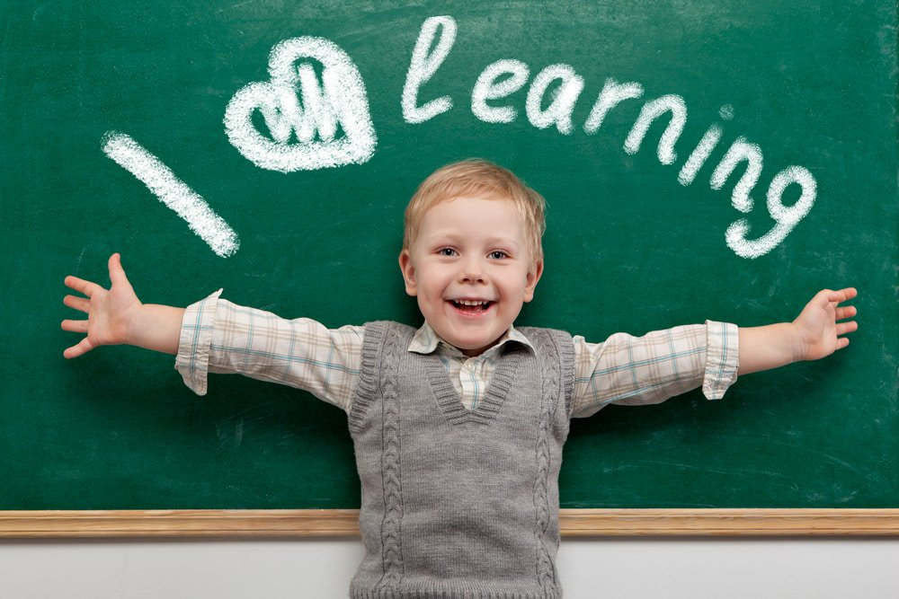
Reinforcement Learning
Definition of Learning from Psychology: Learning is a relatively permanent change in behavior that occurs through experience. It’s a continuous and gradual process.
Image credit: Melbourne Child Psychology & School Psychology Services

Slide 8
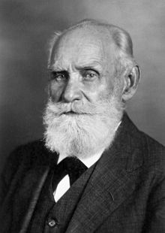
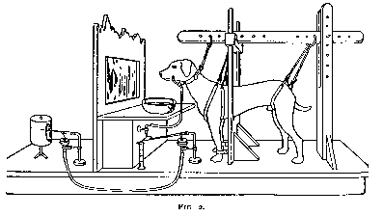
Some more of Psychology
Classical Conditioning: Theory developed by Ivan Pavlov (Nobel prize in 1904).
Classical conditioning is a learning process where an organism learns to associate two stimuli, leading to a change in behavior.
Conditioning Phase: During conditioning, the neutral stimulus (bell) is repeatedly paired with the unconditioned stimulus (food). Over time, the dog begins to associate the bell with the food.
Unconditioned Stimulus (US): This is a stimulus that naturally triggers a response without prior learning. Here, food is the unconditioned stimulus because it naturally causes the dog to salivate.
Conditioned Stimulus (CS): After repeated pairings, the previously neutral stimulus (bell) becomes a conditioned stimulus (CS). Now, the dog salivates even when it hears the bell, without seeing the food.
Conditioned Response (CR): The salivation triggered by the bell is the conditioned response (CR) because it is a learned behavior resulting from the association.
Unconditioned Response (UR): This is an automatic, reflexive reaction to the unconditioned stimulus. For the dog, salivation in response to food is the unconditioned response because it happens instinctively.
A neutral stimulus is something that initially does not trigger the unconditioned response. In your example, the sound of a bell is the neutral stimulus because, by itself, it does not cause the dog to salivate.
Notes:
Food (US) → Salivation (UR). Unconditioned responses and stimuli are natural and unlearned.
Conditioned responses and stimuli are learned through association.
Association: The strength of the learned response depends on the frequency and consistency of pairing the neutral stimulus with the unconditioned stimulus.

Slide 9
Some more of Psychology
Classical Conditioning: Theory developed by Ivan Pavlov (Nobel prize in 1904).
Dog salivates seeing the food (Unconditioned response [salivating] to Unconditioned Stimulus [food])
Dog salivates hearing the bell (Conditioned response [salivating] to Conditioned Stimulus [bell]). Learning to associate bell to salivation via food.
Images credit: Wikipedia

Slide 10
Some more of Psychology
Classical Conditioning: Theory developed by Ivan Pavlov (Nobel prize in 1904).
Fear of Needles:
Unconditioned Stimulus (US): The pain from an injection.
Unconditioned Response (UR): Feeling fear or discomfort.
Neutral Stimulus (NS): The sight of a needle.
Conditioned Stimulus (CS): The sight of a needle after repeated pairings with painful injections.
Conditioned Response (CR): Feeling fear or discomfort when seeing the needle, even before it touches you.
Alarm Clock Startling:
Unconditioned Stimulus US: The loud sound of the alarm.
Unconditioned Response UR: Feeling startled or waking up suddenly.
Neutral Stimulus NS: The specific ringtone or sound of the alarm.
Conditioned Stimulus CS: The ringtone after repeatedly being associated with waking up.
Conditioned Response CR: Feeling startled or alert when hearing the alarm tone, even in a different context.

Slide 11
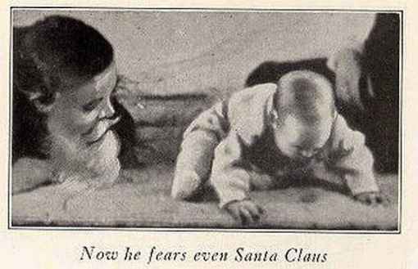
Some more of Psychology
Classical Conditioning: In an experiment with human babies, it was learnt that classical conditioning can occur in humans too.
John B. Watson in 1920 performed his famous “Little Albert experiment”
Mary Cover Jones in 1924 performed her “Little Peter experiment” to show that “counter conditioning” is possible for human subjects.
In her Little Peter experiment, she demonstrated that fear could be reduced or eliminated in children through counterconditioning.

Slide 12
Some more of Psychology
Mary Cover Jones in 1924 performed her “Little Peter experiment” to show that “counter conditioning” is possible for human subjects.
The Experiment:
Initial Problem:
Peter, a young boy, had a fear of rabbits (a phobia). When a rabbit was brought close to him, he exhibited fear and distress.
The Approach:
Jones introduced a rabbit (the feared stimulus) into the same room as Peter.
At the same time, she provided Peter with a pleasant and enjoyable stimulus: his favorite food (e.g., milk and crackers).
The rabbit was initially kept at a distance where Peter felt no fear but could still see it.
Gradual Desensitization:
Over time, the rabbit was moved progressively closer to Peter while he continued to eat and enjoy his favorite food.
The positive experience of eating helped Peter form a new association with the rabbit, replacing fear with comfort.
Outcome:
Eventually, Peter was able to touch and interact with the rabbit without fear.
This demonstrated that phobias and conditioned fears could be countered through new positive associations.

Slide 13
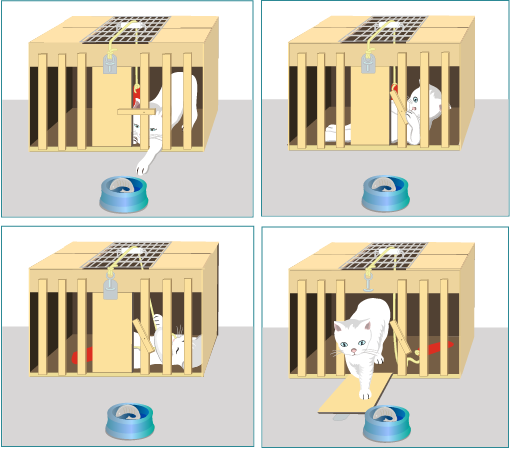
Some more of Psychology
At a similar time, Edward Thorndike was conducting experiments on cats to see how positive/negative feedback affects goal directed learning.

Slide 14
Some more of Psychology
The Law of effect [Thorndike, 1911]:-
“Of several responses made to the same situation, those which are accompanied or closely followed by satisfaction to the animal will, other things being equal, be more firmly connected with the situation, so that, when it recurs, they will be more likely to recur; those which are accompanied or closely followed by discomfort to the animal will, other things being equal, have their connections with that situation weakened, so that, when it recurs, they will be less likely to occur. The greater the satisfaction or discomfort, the greater the strengthening or weakening of the bond.”
This is later studied more by B. F. Skinner and he popularized the term Operant Conditioning.
Pigeons were provided food grains as reward for some “appropriate” behavior.
Skinner also came up with “Pigeon guided missiles” using similar principle.

Slide 15
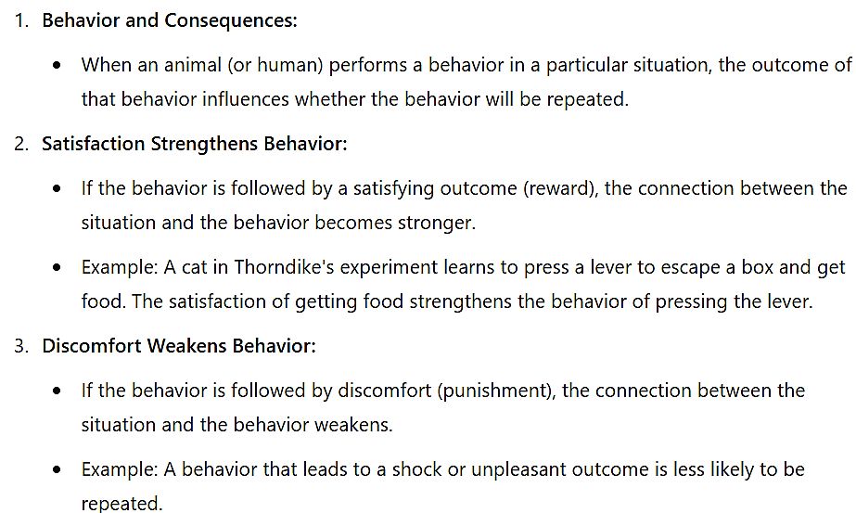
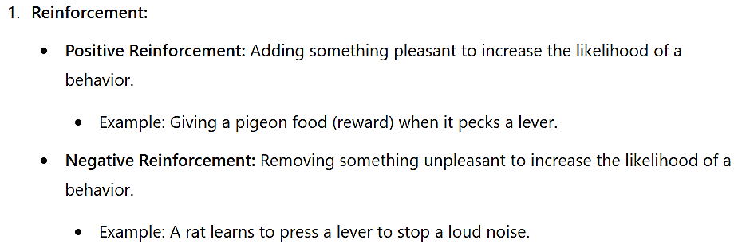
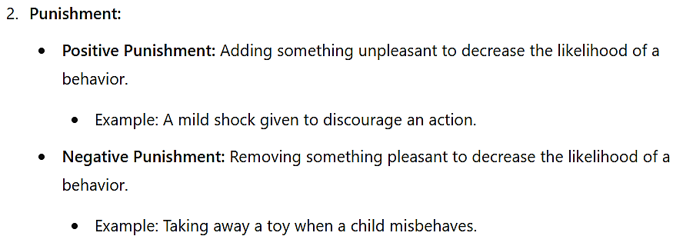
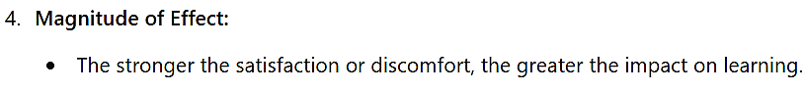
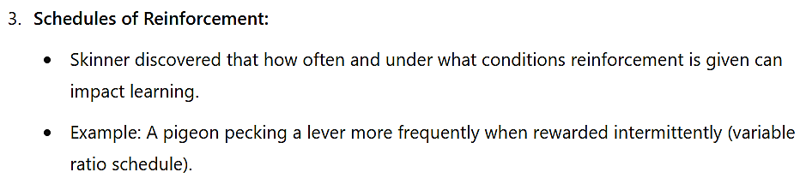
The Law of Effect, proposed by Edward Thorndike in 1911, describes the basic principle of learning through consequences. It states that behaviors followed by satisfying outcomes are more likely to occur again, while those followed by discomfort or unpleasant outcomes are less likely to be repeated.
Operant Conditioning (B. F. Skinner):
Skinner built on Thorndike's work by focusing on how behavior is shaped by reinforcement and punishment. He developed more structured experiments and tools to study this principle, such as the Skinner box.

Slide 16
Some more of Psychology
Reinforcement/Punishment:- In Psychological terms, Reinforcement is a consequence that causes a behavior to occur with greater frequency. Punishment is a response or consequence that causes a behavior to occur with less frequency.
Reinforcement can also mean removal of aversive consequence (Negative Reinforcement).
Similarly, Punishment can also mean removal of rewarding consequence (Negative Punishment).

Slide 17
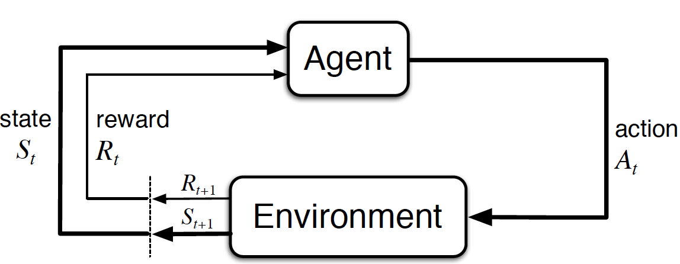
Reinforcement Learning Setting
Agent:- The learner or the decision maker.
Environment:- The thing the learner interacts with, comprising everything outside the agent.
They interact continually. The agent selects actions. The environment responds to these actions by presenting new situation and giving rewards for the action.

Slide 18
Reinforcement Learning Setting
Reward:- Rewards are scalar measures defining what are the good and bad events for the agent.
Value:- Value of a state is the total amount of reward an agent is expected to get in future starting from that state.
Sutton and Barto

Slide 19
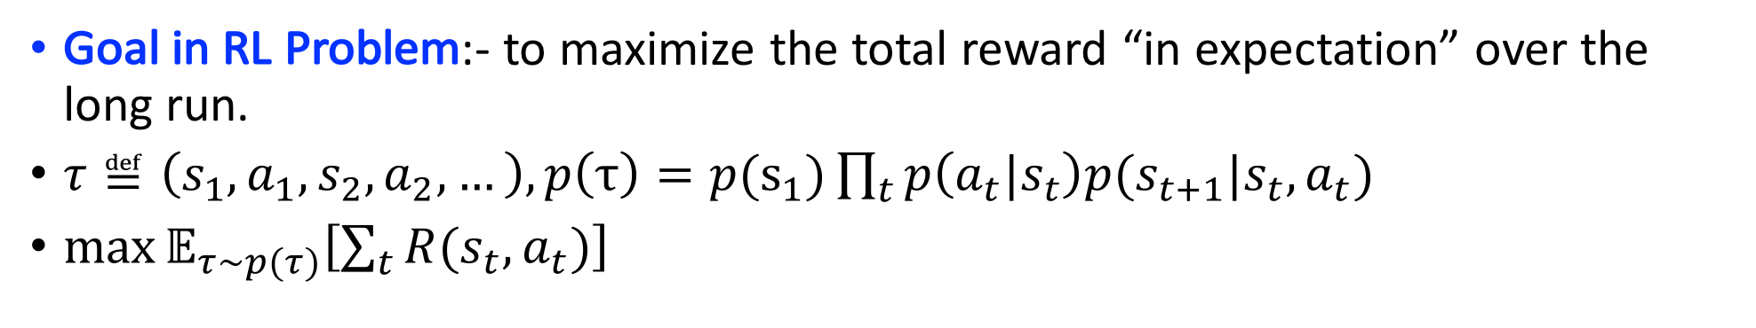
Reinforcement Learning Setting
Goal in RL Problem:- to maximize the total reward “in expectation” over the long run.
$τ≝\left(s_{1},a_{1},s_{2},a_{2},…\right), p\left(τ\right)=p(s_{1})\prod_{t}{p\left(a_{t}|s_{t}\right)p(s_{t+1}|s_{t},a_{t})}$
$\max{𝔼_{τ\sim p(τ)}\left[\sum_{t}{R(s_{t},a_{t})}\right]}$

Slide 20
Distinguishing Features of Reinforcement Learning
Trial and error:- The learner is not told which actions to take, but instead must discover which actions are most rewarding by trying them.
Delayed rewards:- Actions may affect not only the immediate reward but also the next situation and, through that, all subsequent rewards.
Exploration-vs-exploitation:-
- Sutton and Barto

Slide 21
When to use Reinforcement Learning
Trajectories:- Data comes in the form trajectories.
Decisions:- Need to take decisions that affect the trajectory data.
Feedback:- Need to get feedback about the choice of actions.

Slide 22

Supervised, Unsupervised and Reinforcement Learning
Supervised Learning:- Learn $y=f(x)$ – You are given a bunch of $(x,y)$ pairs and your goal is to find the function $f$ mapping $x$ to $y$.
Unsupervised Learning:- Learn $f(x)$ – You don’t have access to any $y$, you are given a bunch of $x^{′}s$ and your goal is to find some $f$ that gives a “compact description” of these $x^{′}s$.
Reinforcement Learning:- Learn $y=f(x)$, given $z$ – You are given a bunch of $(x,z)$ pairs and your goal is to find the function $f$ mapping $x$ to $y$.
$x$ is state, $y$ is action, $z$ is reward

Slide 23
Supervised, Unsupervised and Reinforcement Learning
Supervised Learning:- Does not involve the problem of temporal credit assignment and exploration.
Unsupervised Learning:- Here, in addition, the correct labels are not available

Slide 24
RL Algorithm Landscape
Slide credit: Deep RL Bootcamp, 2017

Slide 25
Stems
Dynamic Programming based Methods
Policy Optimization
Actor-Critic Methods
Advanced Policy Optimization

